Slide 1
EDA for Cab Company
Xiaoyan Zhang
05-17-2024

Slide 2
Agenda
Introduction
Data Input
Data Analysis
Statistical Test
Recommendation and insights

Slide 3
Introduction
To gain insights into the operational performance, market positioning, and customer satisfaction levels of Yellow Company and Pink Company. This will help XYZ firm make an informed decision on which company presents the best investment opportunity.

Slide 4
Data Input
Table Name | N of obs | N of Features | Table Description
Transaction | 440099 | 3 | Transaction of customers
Customer | 49172 | 4 | The customer information
City | 21 | 3 | The city information
Cab_data | 359393 | 7 | Transaction of the Cab Company

Slide 5
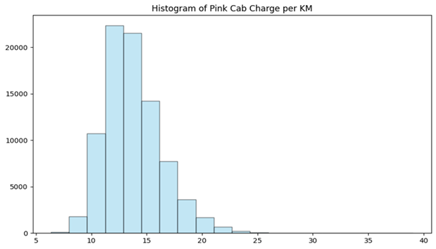
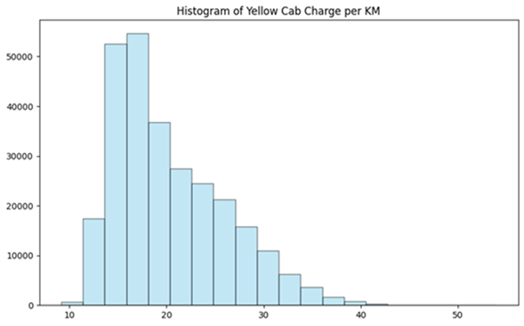
Data Analysis
The charge from Pink Cab is mainly between 10-17, it is nearly normal distributed.
The charge from Pink Cab is mainly between 12- 25, it is right skewed with fat tail.

Slide 6
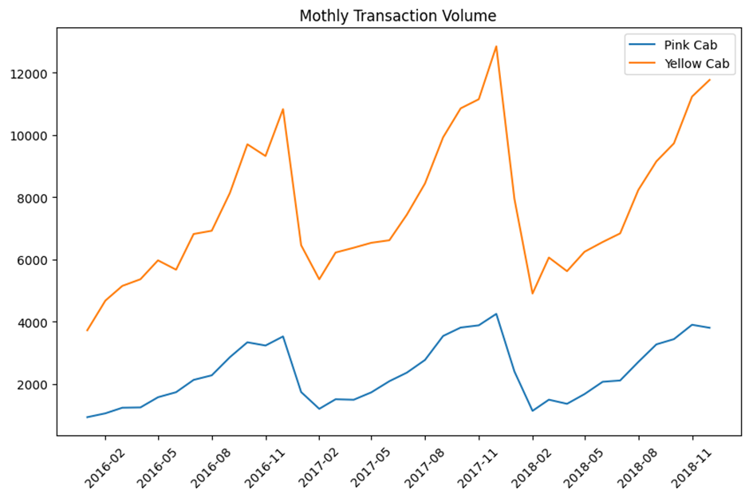
Data Analysis
The transaction volume from Yellow Cab is lager than Pink Cab during 2016-2018. It has seasonality increase because of the holidays. The transaction volume of both company is steadily increased compared with the previous year.

Slide 7
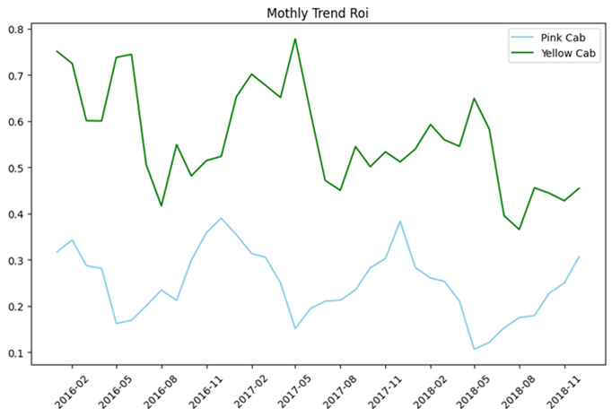
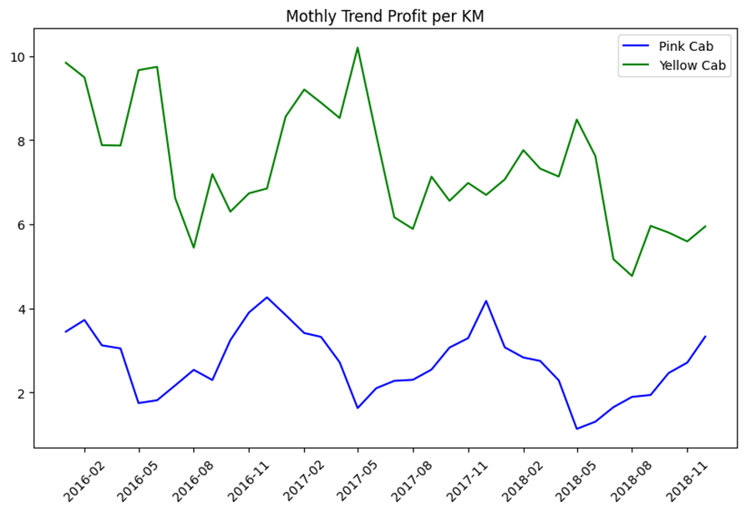
Data Analysis
The monthly trend of return of investment has cyclical growth, the growth rate from Yellow Cab is slower than Pink Cab in 2018.
The monthly trend profit per kilometer from Yellow Cab is more than Pink Cab.

Slide 8
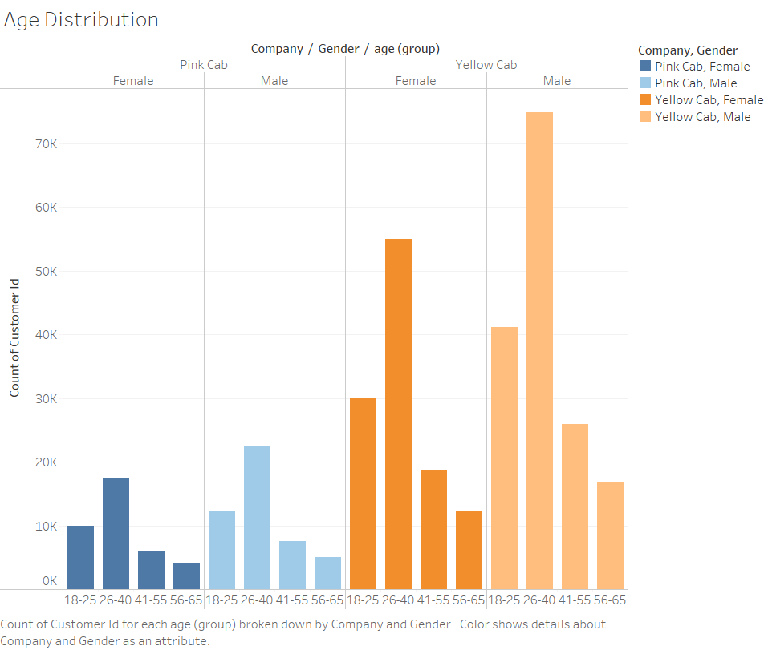
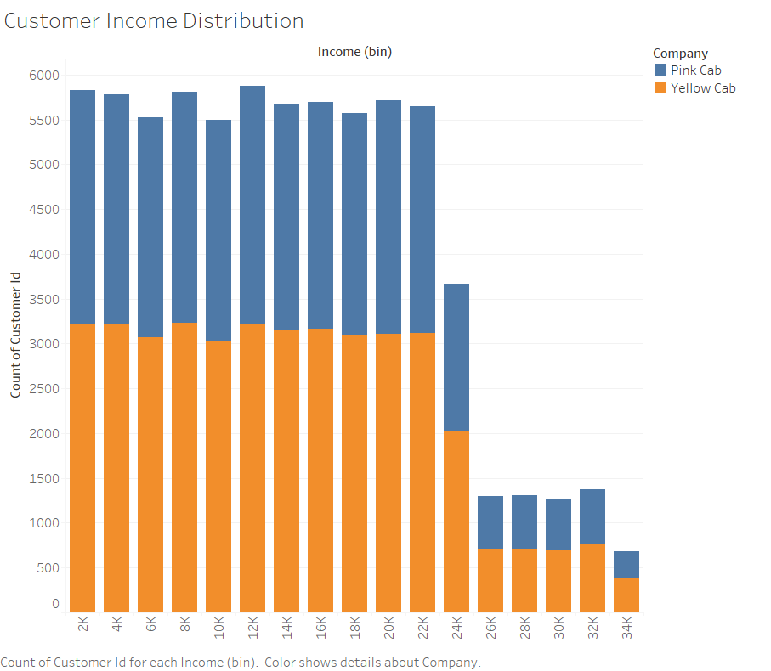
Data Analysis
From the ratio of customer’s gender, age, income, there’s no difference between Yellow Cab and Pink Cab

Slide 9
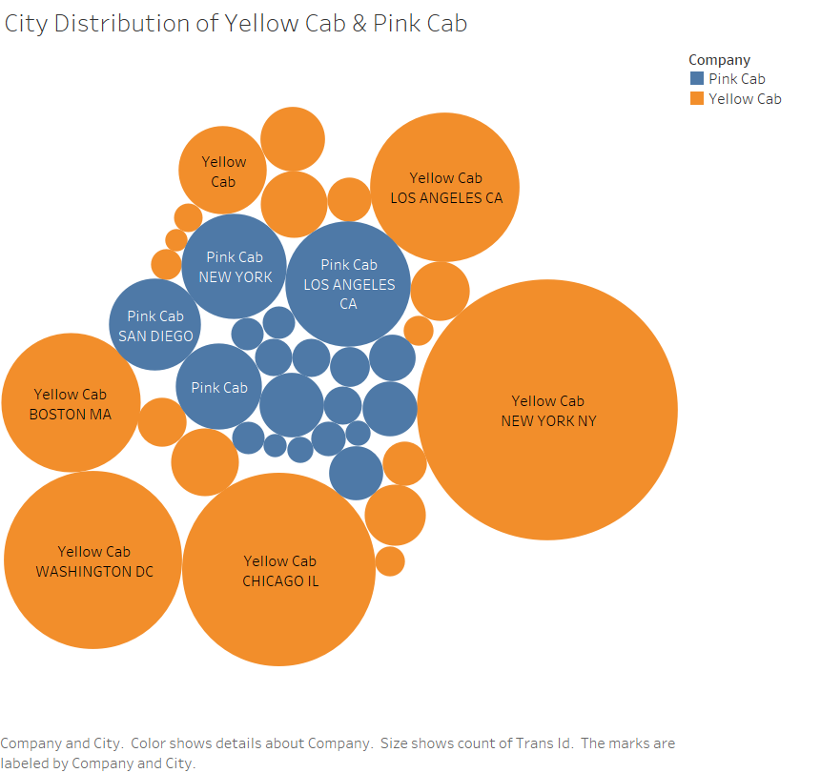
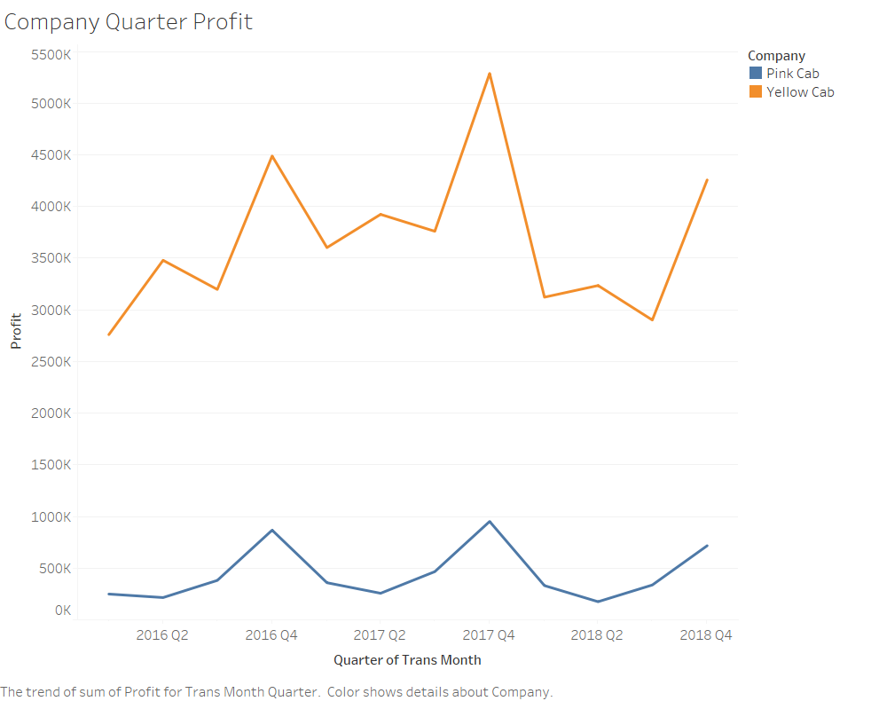
Data Analysis
From city distribution the 2 Cab company have operation in large city in the east and west coasts , Yellow has the larger volume. From company Quarter Profit, the 2 company’s profit is increase, Yellow Cab is more profitable than Pink Cab.

Slide 10
Statistical Test
Test 1
H0: The profit per kilometer of Pink company and Yellow company are the same
H1: The profit per Kilometer of Pink company and Yellow company are different
t-statistic: -160.3715175947806, p-value:0.0, reject the null hypothesis. The profit per kilometer of Pink company and Yellow company are different.

Slide 11
Test 2
H0: The mean of return of investment of Pink company is greater than Yellow company
H1: The mean of return of investment of Pink company is less than Yellow company
t-statistic: -179.2759885217892,
p-value:0.0, Reject the null hypothesis. The mean of roi for Pink Cab is significantly smaller than the mean of roi for Yellow Cab.

Slide 12
Test 3
H0: The average age of customer from Pink company is the same as the customer from Yellow company
H1: The average age of customer from Pink company is different as the customer from Yellow company
t-statistic: 0.31633759975120346 p-value: 0.7517471890396208 Fail to reject the null hypothesis. There is no significant difference between the average age of Pink company and Yellow company.

Slide 13
Test 4
H0: The average income of customer from Pink company is the same as the customer from Yellow company
H1: The average income of customer from Pink company is the different from the customer from Yellow company
t-statistic: 0.838939895792237 p-value: 0.40150581507996785 Fail to reject the null hypothesis. There is no significant difference between the average income of Pink company and Yellow company.

Slide 14
Test 5
H0: The gender distribution of customer from Pink company is the same as Yellow company
H1: The gender distribution of customer from Pink company is different from Yellow company
Chi-square statistic: 0.5063792600762221 P-value: 0.47671046144863083
Since the p-value (0.4767) is greater than the chosen significance level (commonly 0.05), we fail to reject the null hypothesis. This means that there is not enough evidence to conclude that there is a significant association between the gender of customers and the company they choose.

Slide 15
Recommendation
Based on the above analysis and hypothesis testing, Yellow Cab is better than Pink Cab in terms of total number of customers, profit per KM and return of investment.
Our recommendation is to invest the Yellow Cab company

